Slide 1
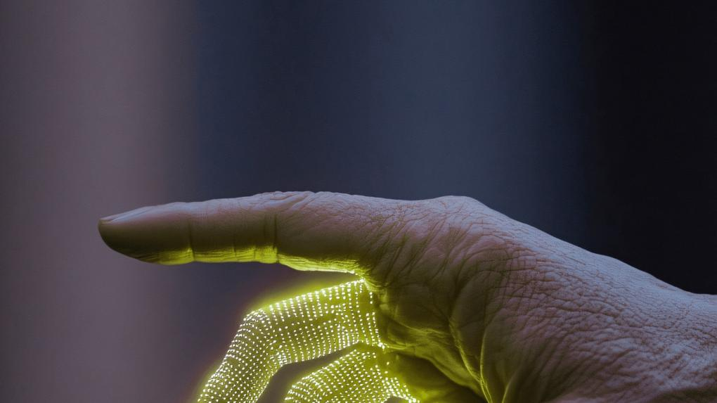

October 16th and 17th · Barcelona
18th IBEC SYMPOSIUM
BIOENGINEERING FOR PRECISION MEDICINE
#IBECSymposium

Slide 2
18th IBEC SYMPOSIUM · BIOENGINEERING FOR PRECISION MEDICINE
Title
Speaker
#IBECSymposium

Slide 3


18th IBEC SYMPOSIUM
BIOENGINEERING FOR PRECISION MEDICINE

Slide 4

18th IBEC SYMPOSIUM
BIOENGINEERING FOR PRECISION MEDICINE

Slide 5









ibecbarcelona.eu

